Slide 1
Causal inference: an introduction
Neil M Davies
University of Bristol
MRC Integrative Epidemiology Unit
2nd October 2020
All the materials are available here:
https://github.com/nmdavies/causal_inf_course/

Slide 2
Overview
Causal questions
The potential outcomes framework
Directed acyclic graphs (DAGs)
Causal methods
Sources of bias
Simulations

Slide 3
Questions in epidemiology
Descriptive
What is the incidence of a disease in the population?
Does the burden of disease differ within different groups?
Causal
1993 - Does vitamin E reduce the rate of cardiovascular disease?
2020 - Does hydroxychloroquine affect severity of COVID?
Well conducted observational studies effective for descriptive stats
Are they any good for causal questions?

Slide 4
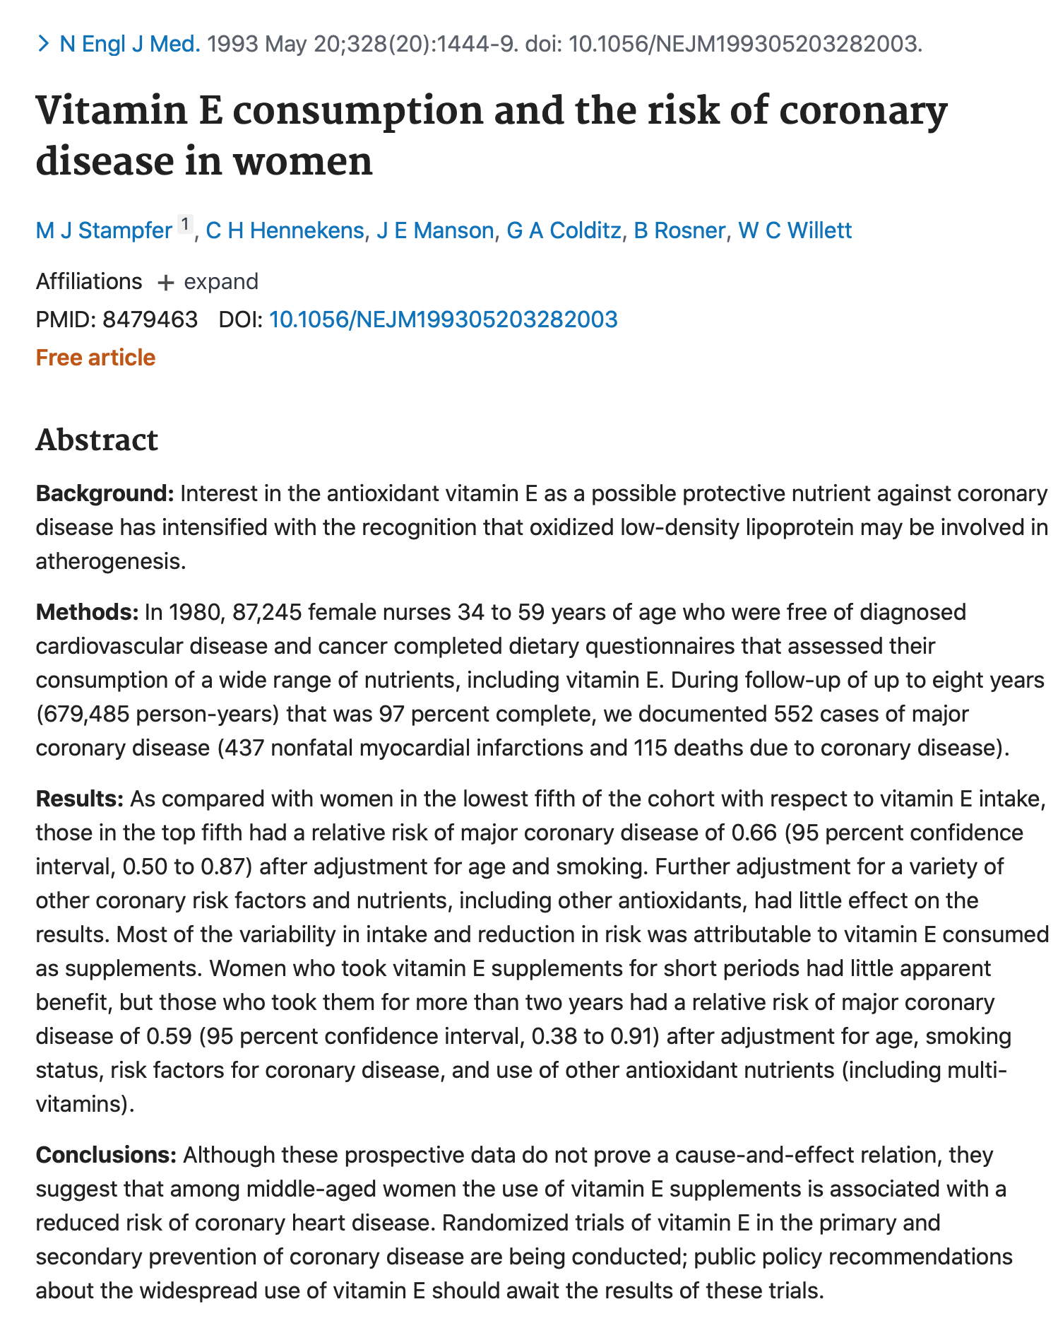
Does taking vitamin E reduce risk of cardiovascular disease?
Observational study: negative association
RR=0.59 95%CI: 0.38 to 0.91
Vit E helps!
Stampfer, M. J., C. H. Hennekens, J. E. Manson, G. A. Colditz, B. Rosner, and W. C. Willett. 1993. “Vitamin E Consumption and the Risk of Coronary Disease in Women.” The New England Journal of Medicine 328 (20): 1444–49. https://doi.org/10.1056/NEJM199305203282003.

Slide 5
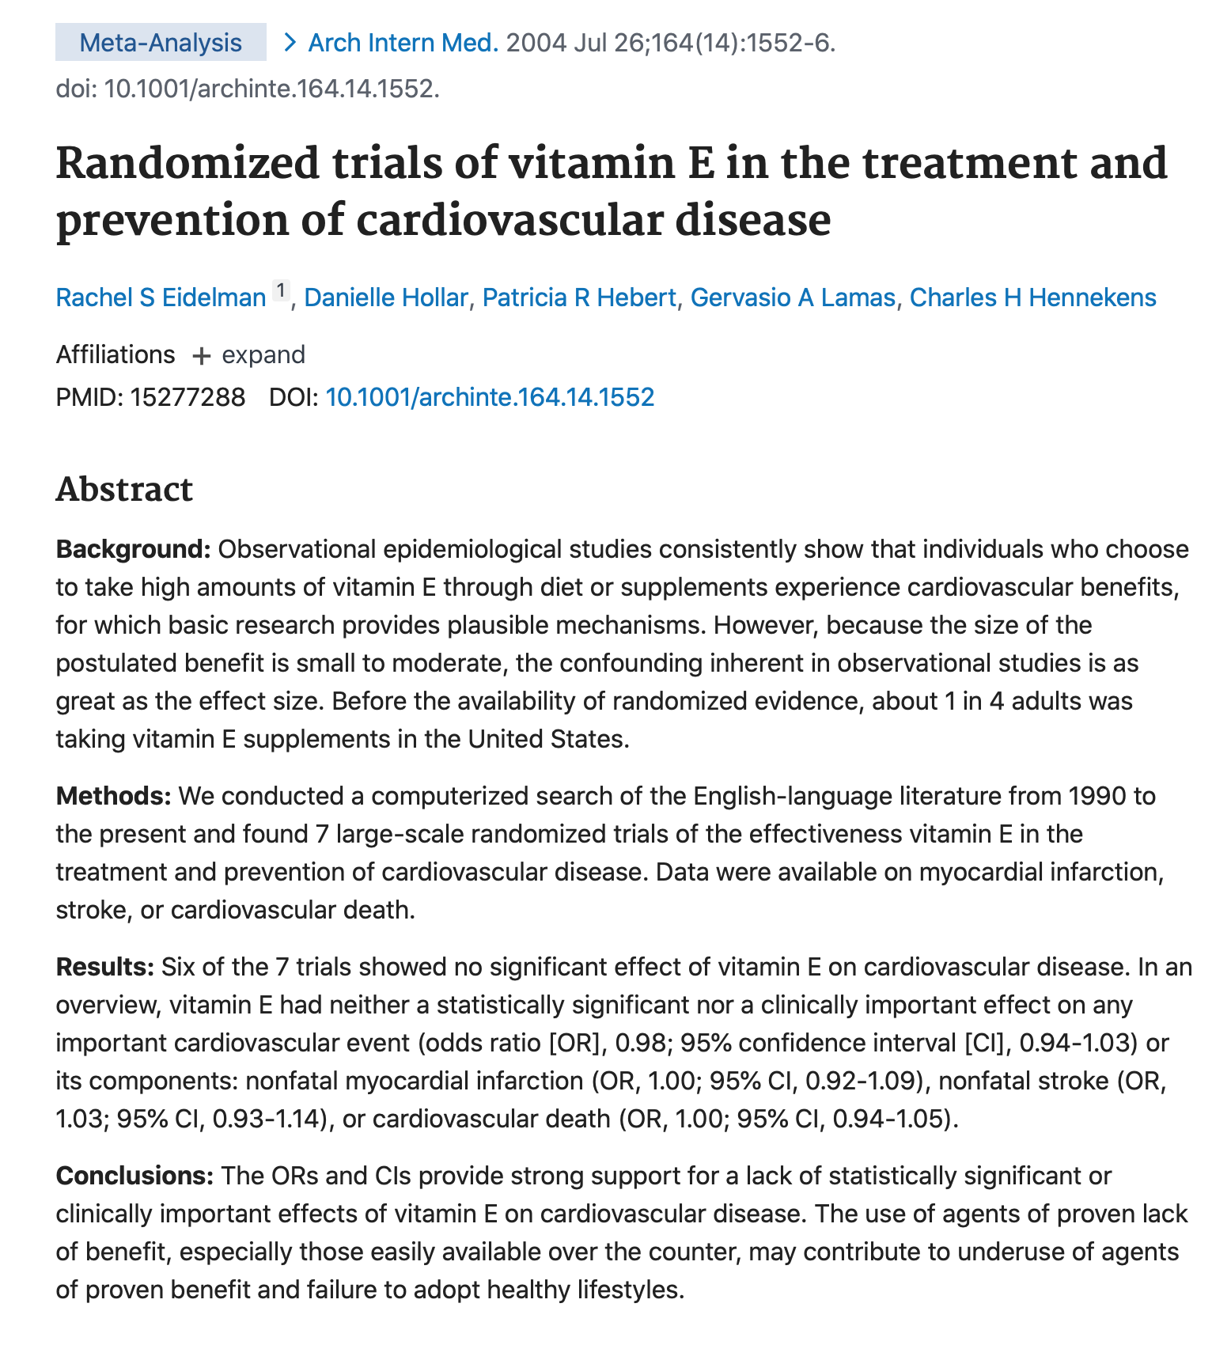
Does taking vitamin E reduce risk of cardiovascular disease?
Meta-analysis of RCTs: no evidence of an effect
OR=0.98 95%CI: 0.94 to 1.03
Eidelman, Rachel S., Danielle Hollar, Patricia R. Hebert, Gervasio A. Lamas, and Charles H. Hennekens. 2004. “Randomized Trials of Vitamin E in the Treatment and Prevention of Cardiovascular Disease.” Archives of Internal Medicine 164 (14): 1552. https://doi.org/10.1001/archinte.164.14.1552.

Slide 6
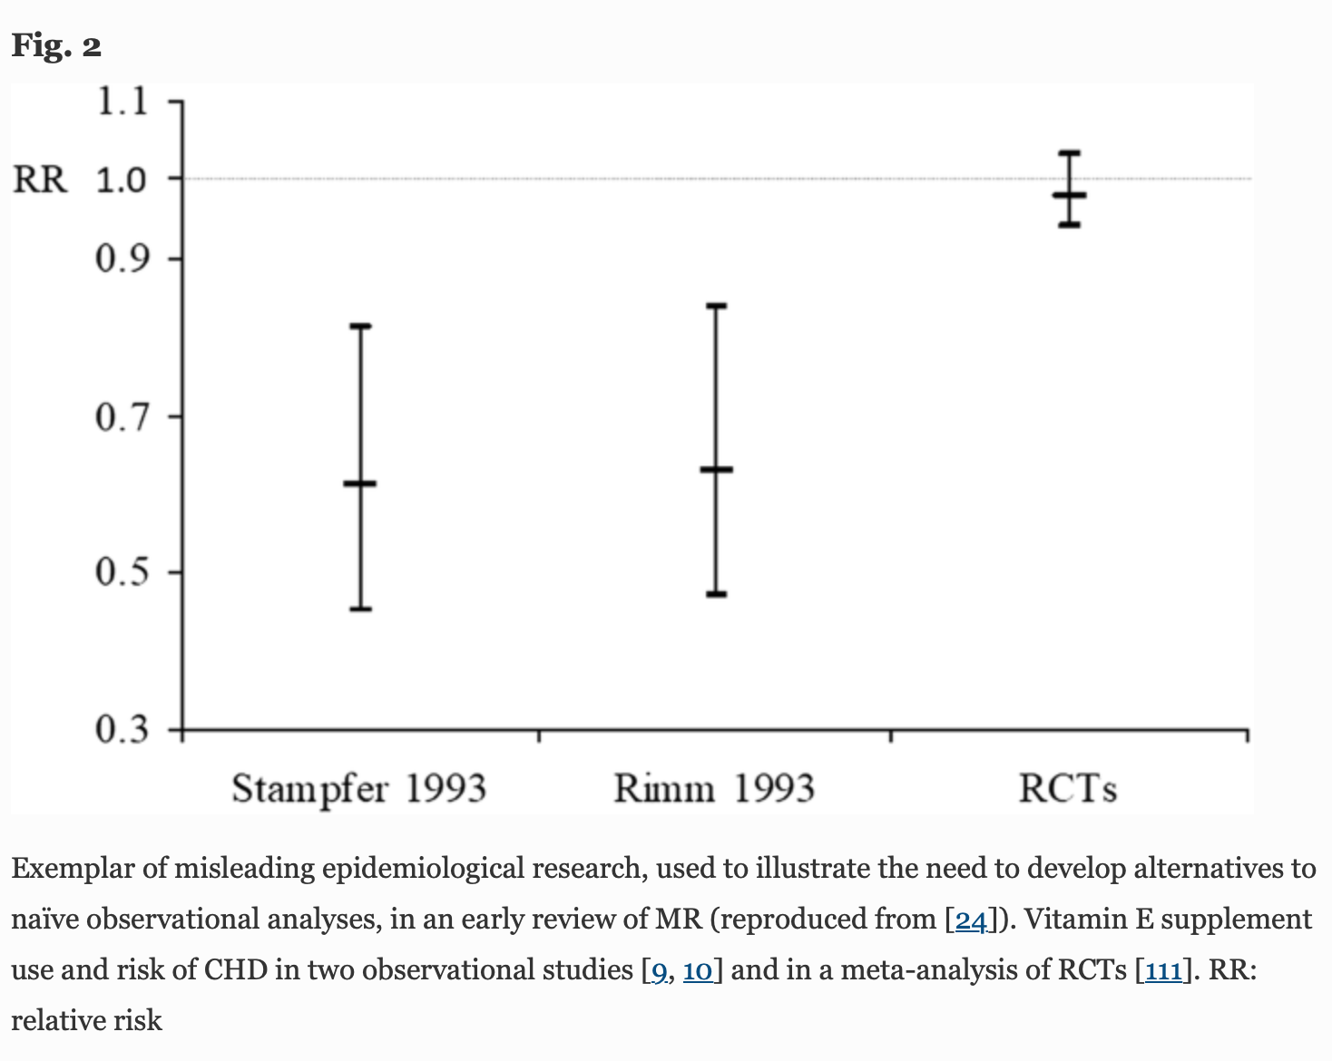
Davey Smith, George, Michael V. Holmes, Neil M. Davies, and Shah Ebrahim. 2020. “Mendel’s Laws, Mendelian Randomization and Causal Inference in Observational Data: Substantive and Nomenclatural Issues.” European Journal of Epidemiology 35 (2): 99–111. https://doi.org/10.1007/s10654-020-00622-7.

Slide 7
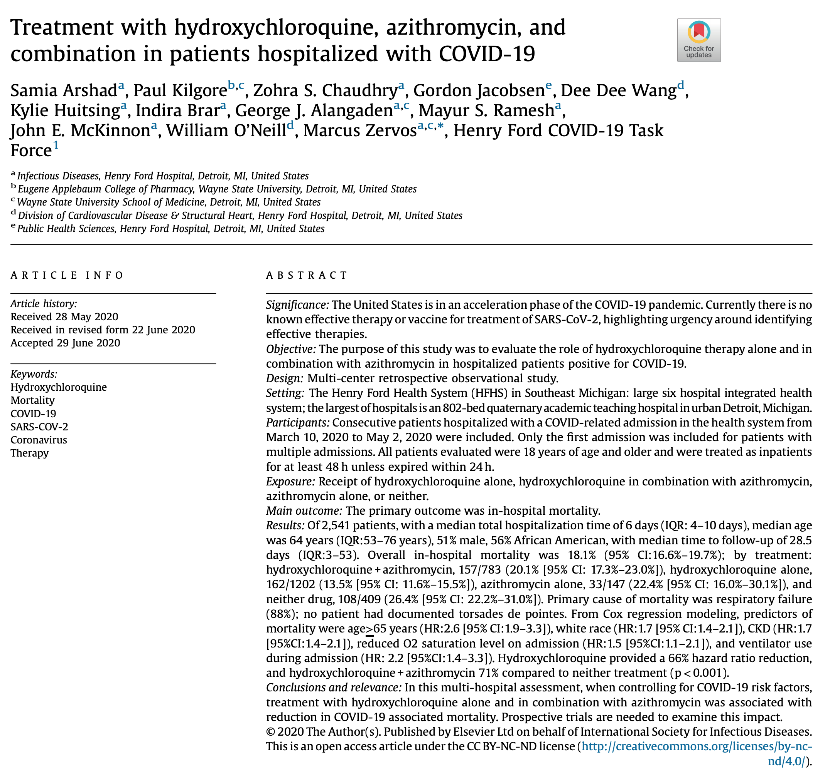
Causal questions
Does hydroxychloroquine reduce rates of mortality for patients admitted to hospital with COVID?
Observational study: negative association
HR=0.34 95%CI: 0.25 to 0.46
Hydroxychloroquine helps!

Slide 8
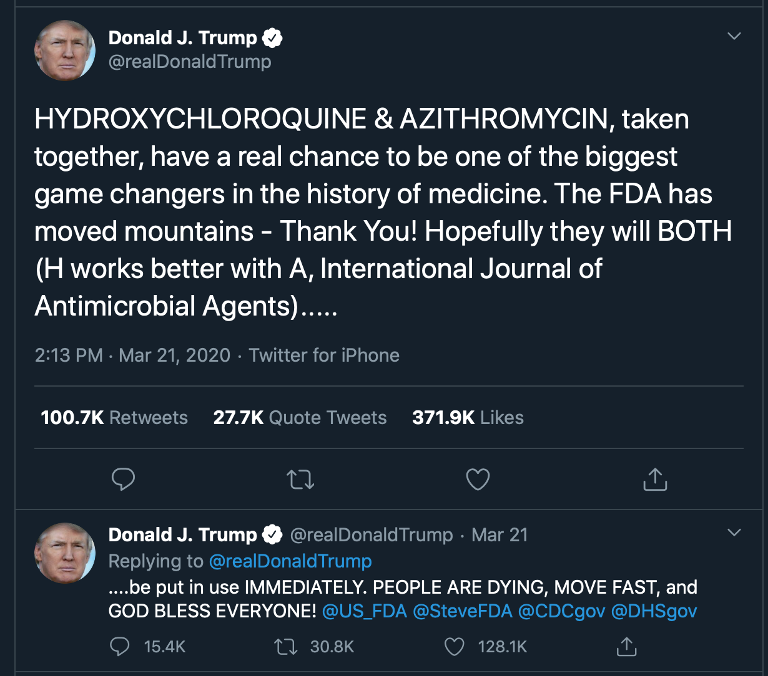
Causal questions
Does hydroxychloroquine reduce rates of mortality for patients admitted to hospital with COVID?
Observational study: negative association
HR=0.34 95%CI: 0.25 to 0.46
Hydroxychloroquine helps!

Slide 9
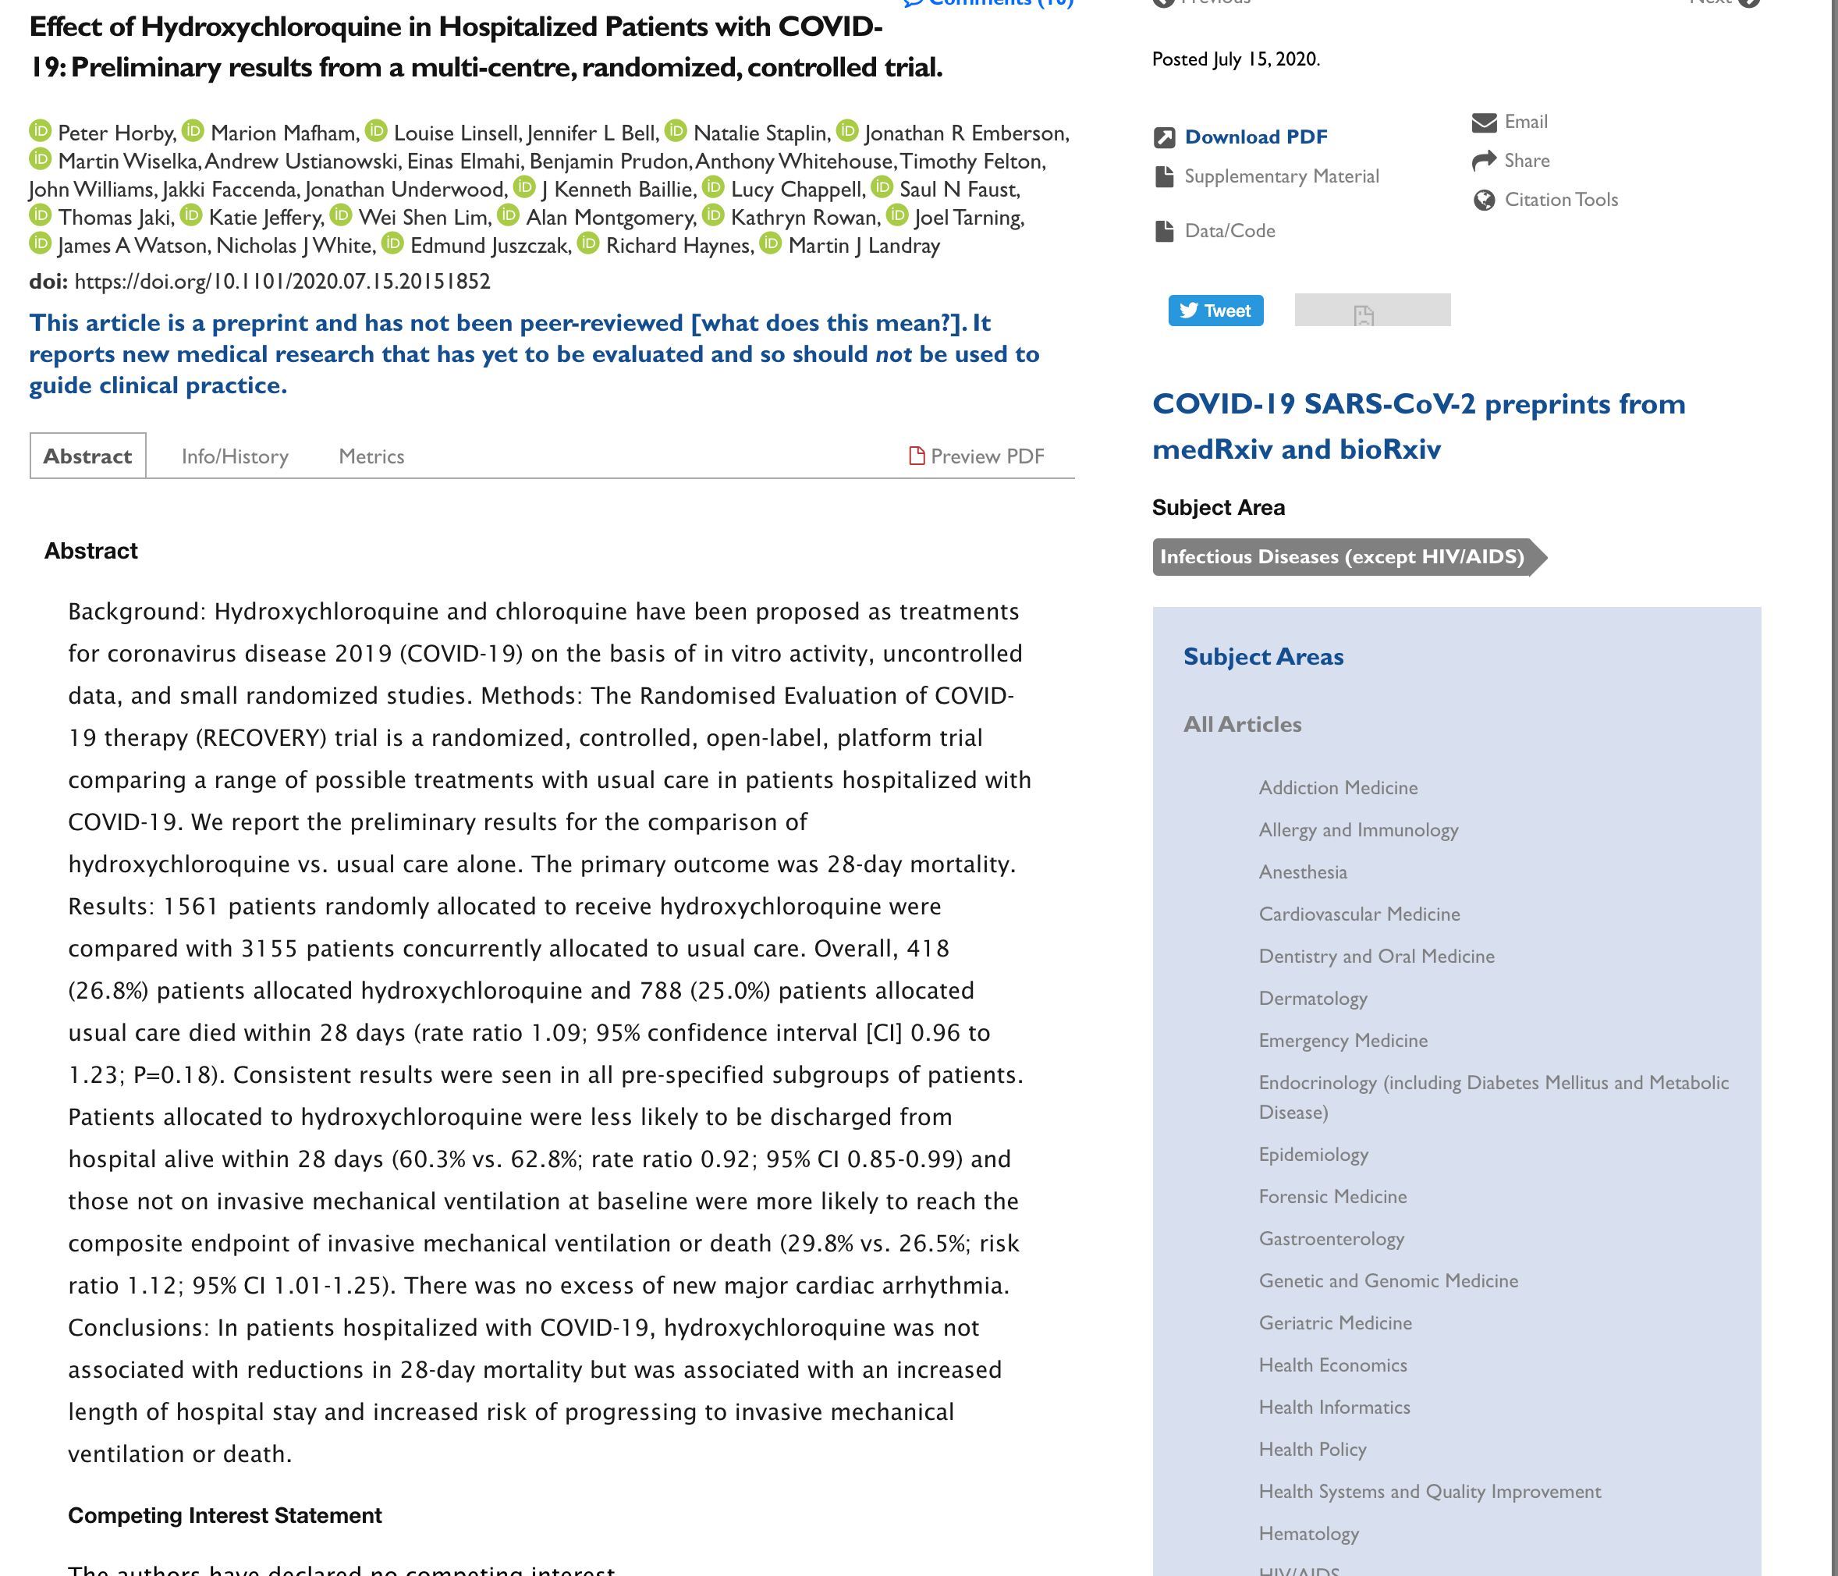
Does hydroxychloroquine reduce rates of mortality for patients admitted to hospital with COVID?
RCT:
RR=1.09 95%CI:0.96 to 1.23
Hydroxychloroquine is unlikely to help treat COVID

Slide 10
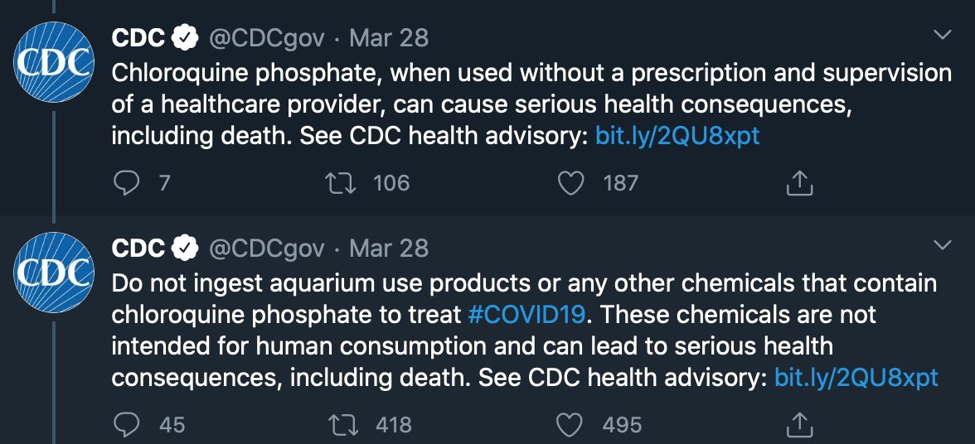
Does hydroxychloroquine reduce rates of mortality for patients admitted to hospital with COVID?
RCT:
RR=1.12 95%CI:1.01 to 1.25
Hydroxychloroquine is unlikely to help treat COVID

Slide 11
Why use causal inference methods?
Observational evidence is very powerful
Precise
Quick
Cheap
Representative
Diverse
Can be very unreliable for causal hypotheses
Confounding bias
Measurement error
Selection/collider bias
Time biases
And many other
Need to use credible methods for analyzing observational data.

Slide 12
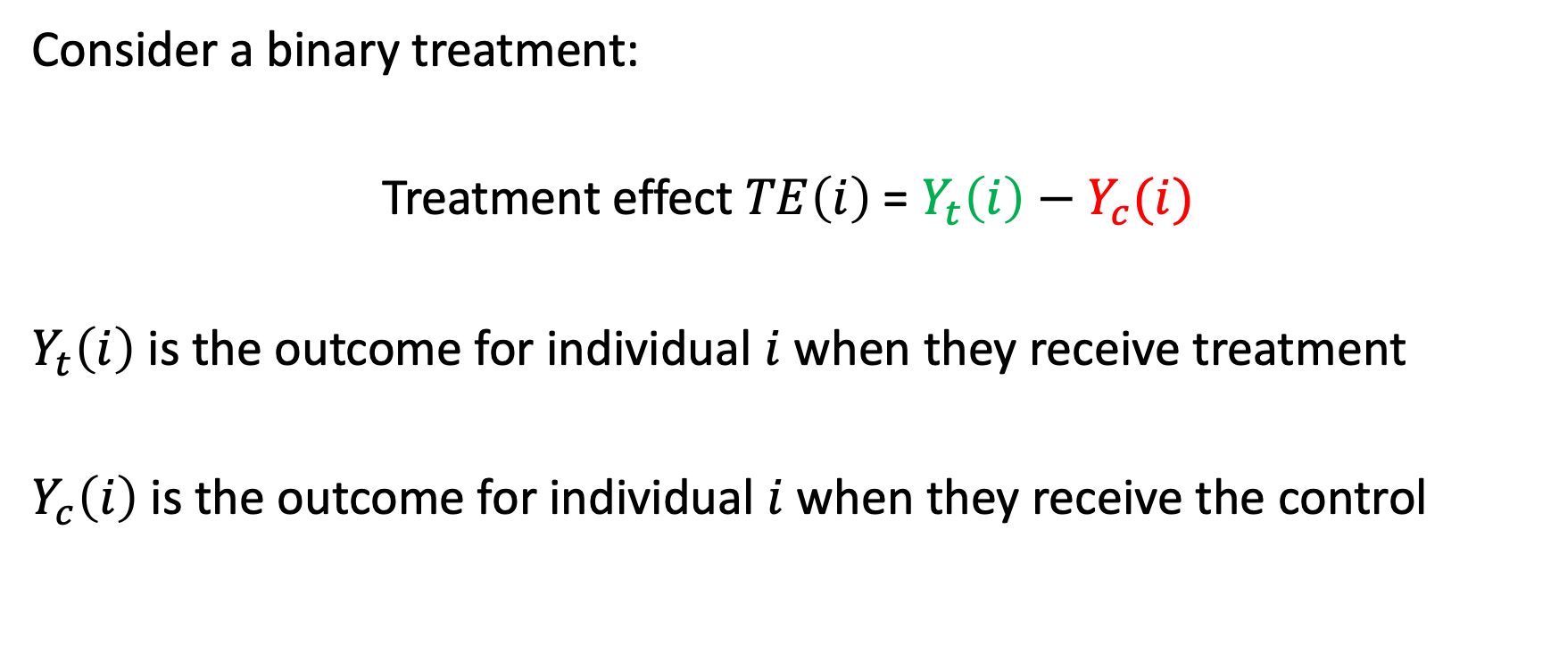
The potential outcomes framework
Consider a binary treatment:
Treatment effect $TE\left(i\right)$= $Y_{t}\left(i\right)−Y_{c}(i)$
$Y_{t}\left(i\right)$ is the outcome for individual $i$ when they receive treatment
$Y_{c}\left(i\right)$ is the outcome for individual $i$ when they receive the control
Hernán, MA, and JM Robins. 2020. Causal Inference. Boca Raton: Chapman & Hall/CRC, forthcoming.
Imbens, Guido, and Donald B. Rubin. 2015. Causal Inference for Statistics, Social, and Biomedical Sciences: An Introduction. New York: Cambridge University Press.
Pearl, Judea. 2000. Causality: Models, Reasoning, and Inference. Cambridge, U.K. ; New York: Cambridge University Press.

Slide 13
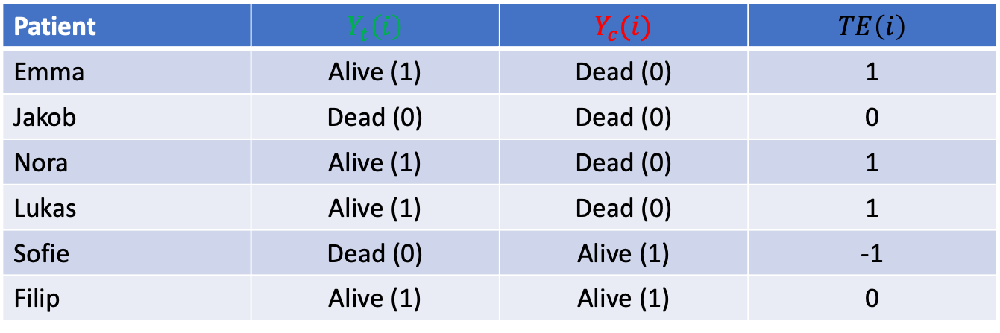
Hypothetical potential outcomes:
Risk difference=66%-33%=33 percentage points
Odds ratio =0.50
Patient | $$Y_{t}\left(i\right)$$ | $$Y_{c}(i)$$ | $TE\left(i\right)$
Emma | Alive (1) | Dead (0) | 1
Jakob | Dead (0) | Dead (0) | 0
Nora | Alive (1) | Dead (0) | 1
Lukas | Alive (1) | Dead (0) | 1
Sofie | Dead (0) | Alive (1) | -1
Filip | Alive (1) | Alive (1) | 0

Slide 14
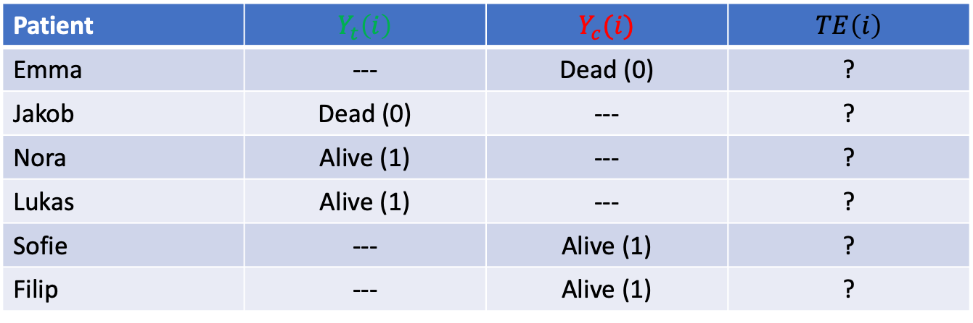
Observed data:
Observed risk difference=0.00
Observed odds ratio =1.00
If treatment is not allocated at random, we cannot know whether the outcomes we observe are representative of the potential outcomes in the population
Patient | $$Y_{t}\left(i\right)$$ | $$Y_{c}(i)$$ | $TE\left(i\right)$
Emma | --- | Dead (0) | ?
Jakob | Dead (0) | --- | ?
Nora | Alive (1) | --- | ?
Lukas | Alive (1) | --- | ?
Sofie | --- | Alive (1) | ?
Filip | --- | Alive (1) | ?

Slide 15
Directed acyclic graphs (DAGs)
Diagrams for understanding problems
Edges = arrows
Nodes = variables
Directed = no bi-directional arrows
Acyclic = cannot have bidirectional relationships
Exposure
Outcome
Hernán, MA, and JM Robins. 2020. Causal Inference. Boca Raton: Chapman & Hall/CRC, forthcoming. https://cdn1.sph.harvard.edu/wp-content/uploads/sites/1268/2020/07/ci_hernanrobins_31july20.pdf

Slide 16
Strengths and limitations of DAGs
Very useful for intuition and general principles
Good for methodologists and methods papers
Useful for informing simulations
Deciding whether to adjust for a variable
is it on the causal pathway from exposure to outcome?
is it a collider of the exposure and outcome?
Not very useful for decision making in empirical analysis
Has my estimate adjusted for a sufficient set of confounders?
Is my estimate likely to have correctly modelled selection?
Which covariates should I include?
Not all sources of bias can be easily illustrated in DAGs
Immortal time bias
Interactions and moderators
Cyclical relationships, complex relationships over time

Slide 17
Confounding bias
A common cause of the exposure and the outcome
The exposure-outcome association will be a biased estimate of the casual effect of the exposure (TE)
If the confounders can be measured, and accounted for, then we can recover an unbiased estimate of the treatment effect.
However, this assumes no unmeasured confounding
This is an incredibly strong, and rarely plausible assumption!
Confounder
Exposure
Outcome

Slide 18
An example of confounding
Age is easily measured, but many other confounders are not, e.g.
Frailty
Co-morbidities
Social support
Behaviors
Life-time exposures
No unmeasured confounding requires that conditional on measured confounders, the exposure is as good as randomized.
I.e. there are no other systematic differences in the potential outcomes between treated and control groups.
Age
Prescribed ACE-Inhibitor
COVID mortality

Slide 19
Selection/collider bias
Selection or conditioning on a common cause of the exposure and the outcome.
The exposure-outcome association will be a biased estimate of the casual effect of the exposure (TE)
If the collider or the variables being selected on are known, and modelled, then we can recover unbiased estimate of the treatment effect.
However, this assumes the study has measured, and knows sufficient factors to explain selection
Exposure
Outcome
Collider

Slide 20
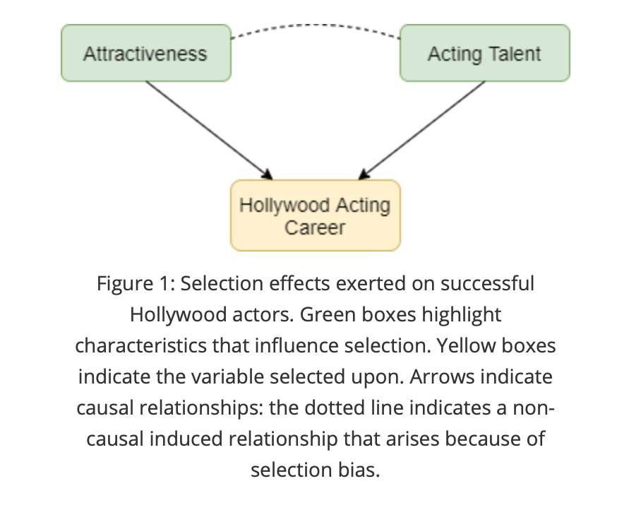
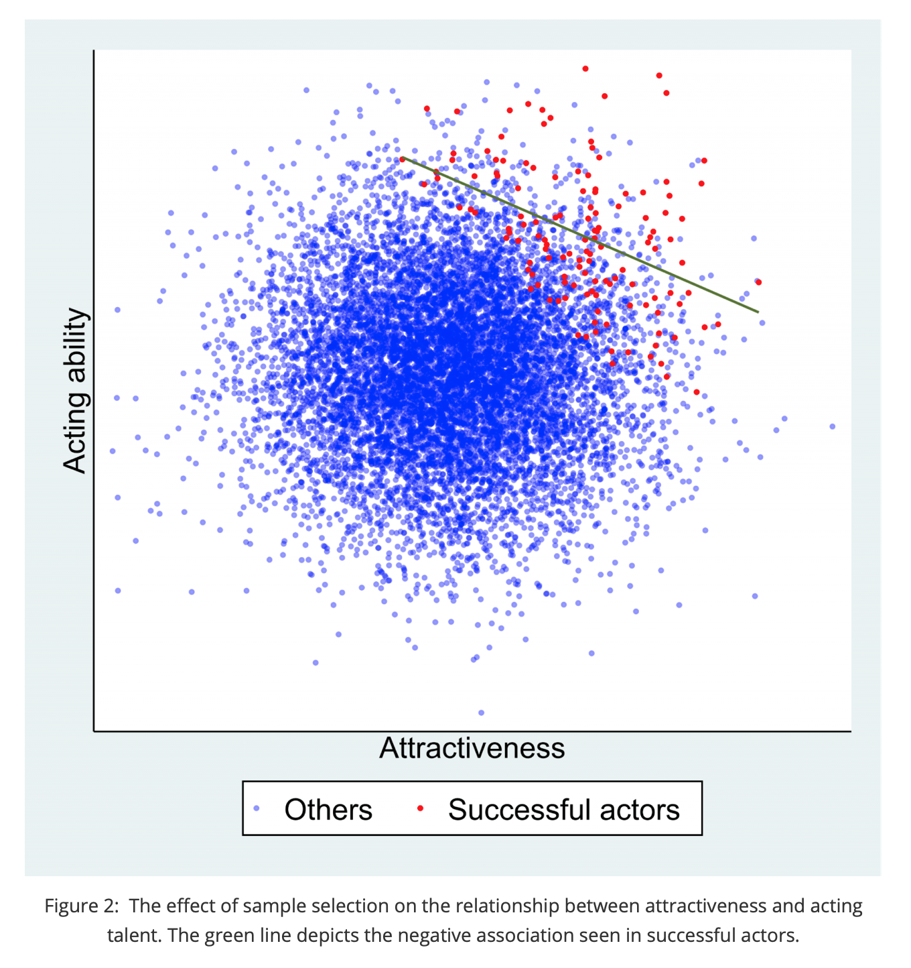
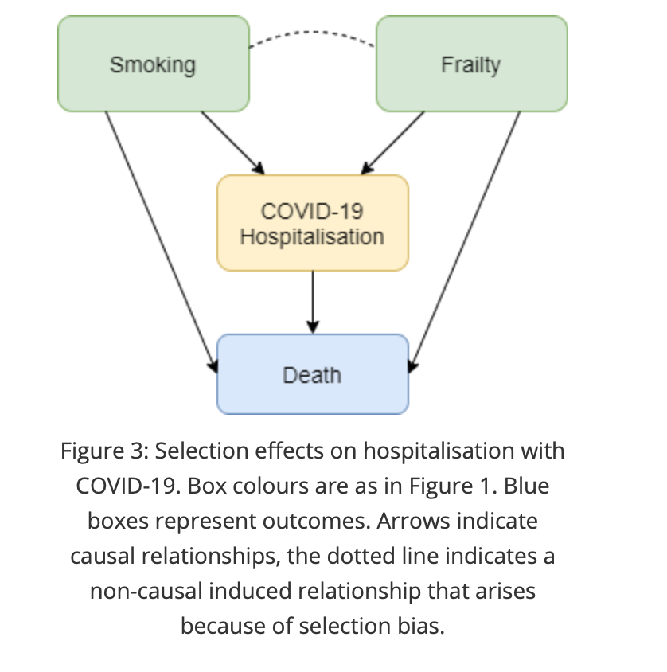
Two examples of collider bias

Slide 21
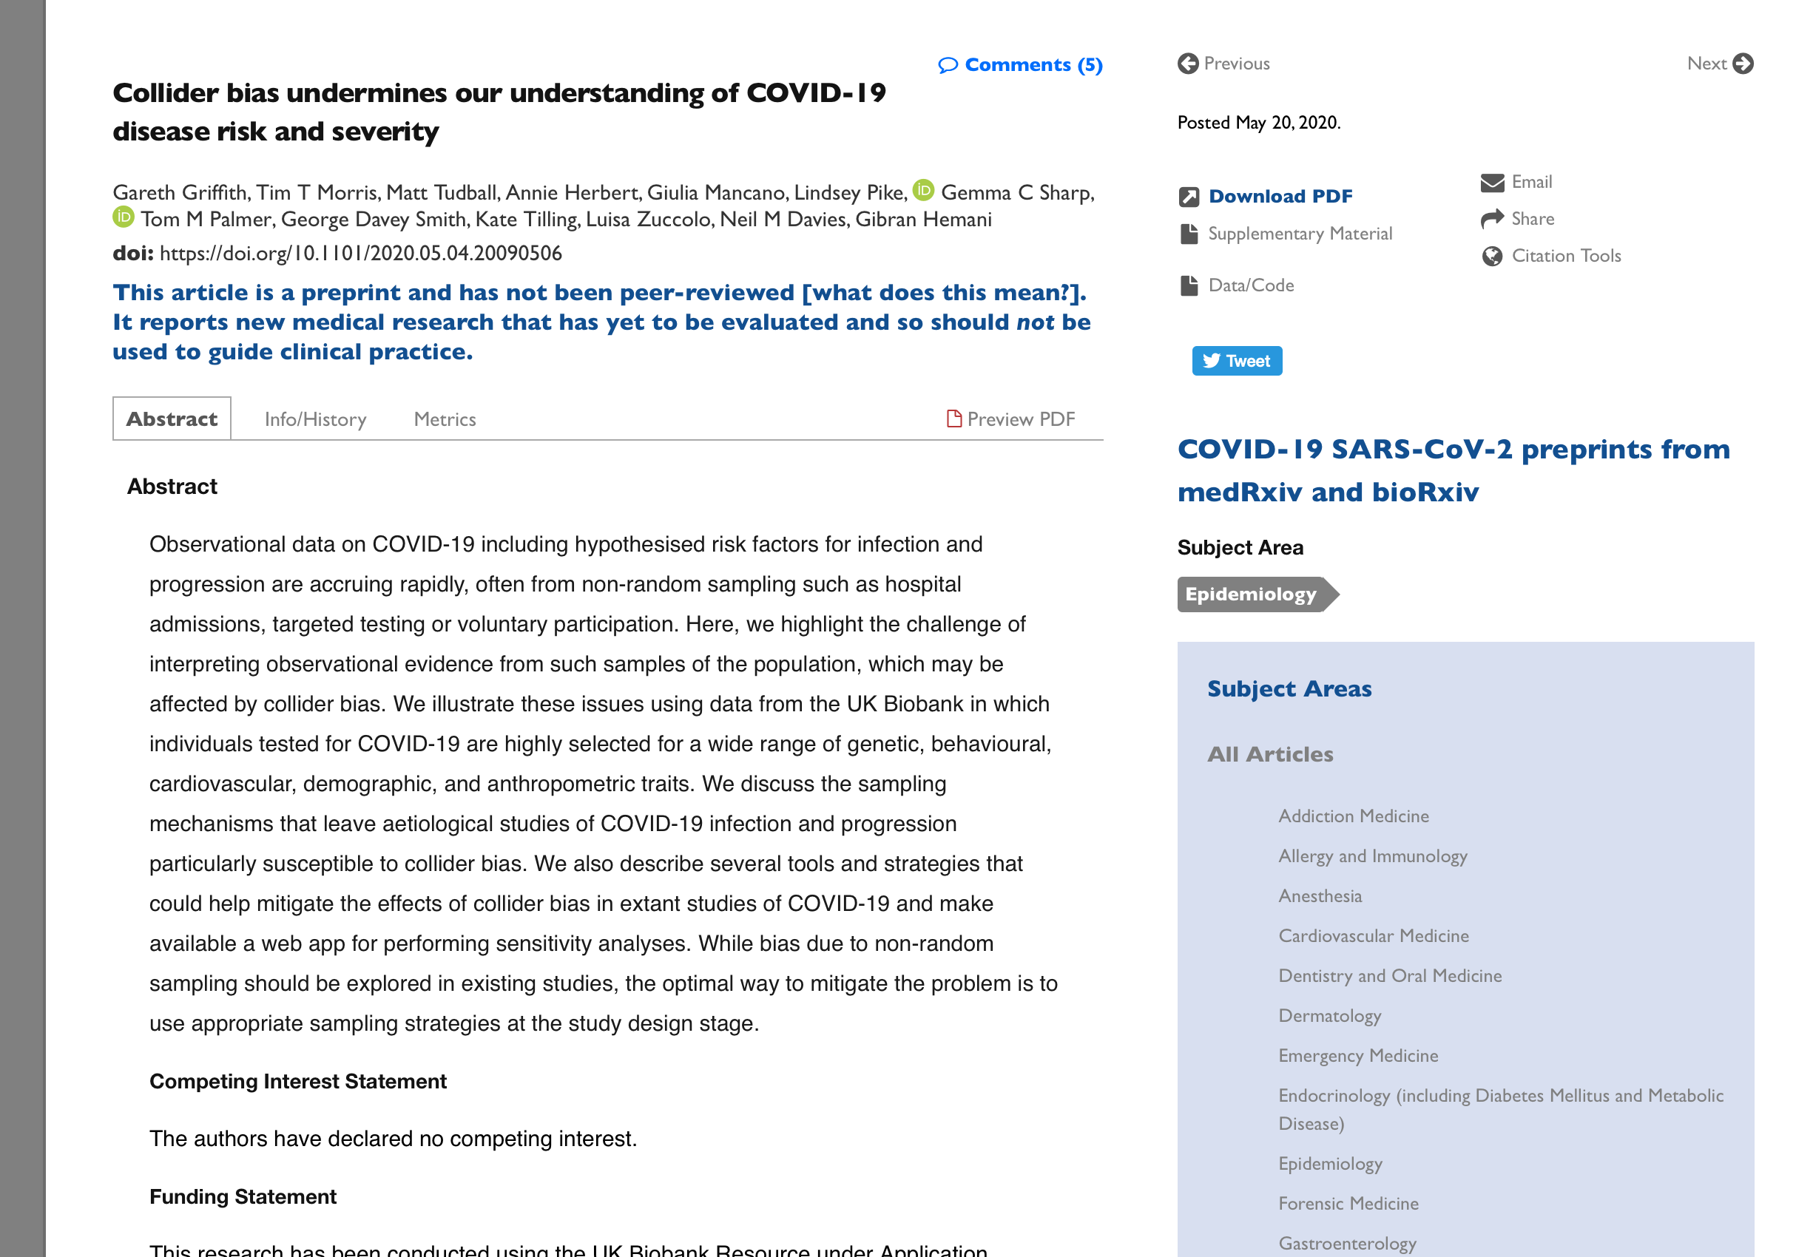
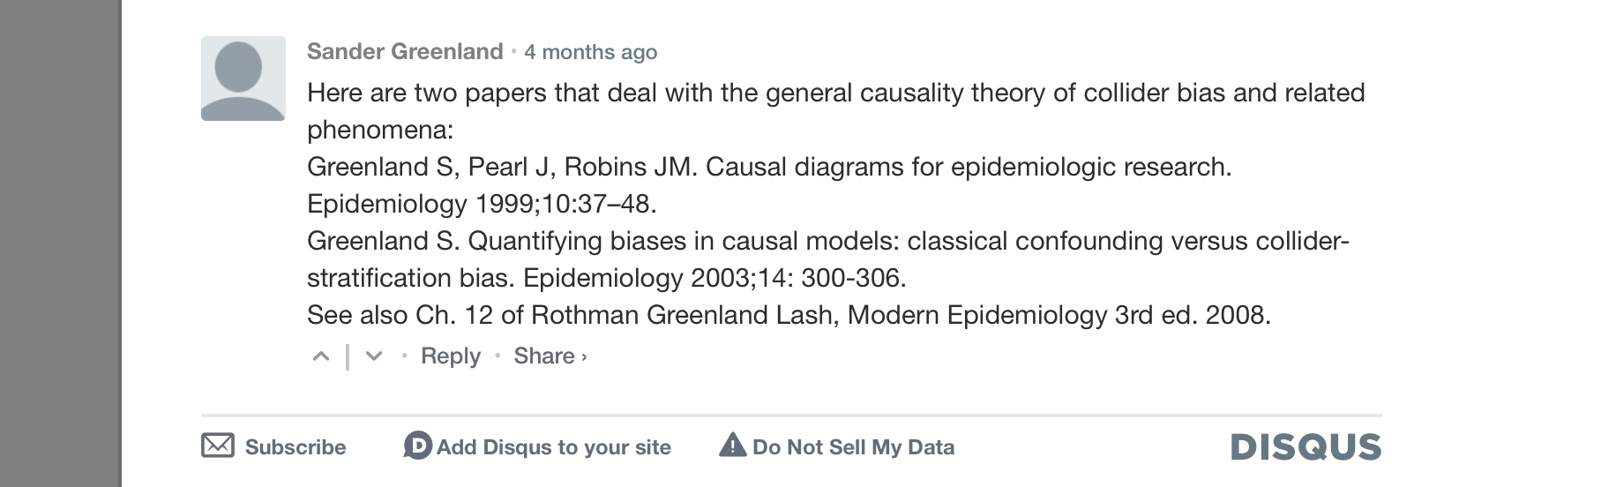
Griffith, Gareth, Tim T Morris, Matt Tudball, Annie Herbert, Giulia Mancano, Lindsey Pike, Gemma C Sharp, et al. 2020. “Collider Bias Undermines Our Understanding of COVID-19 Disease Risk and Severity.” Preprint. Epidemiology. https://doi.org/10.1101/2020.05.04.20090506.

Slide 22
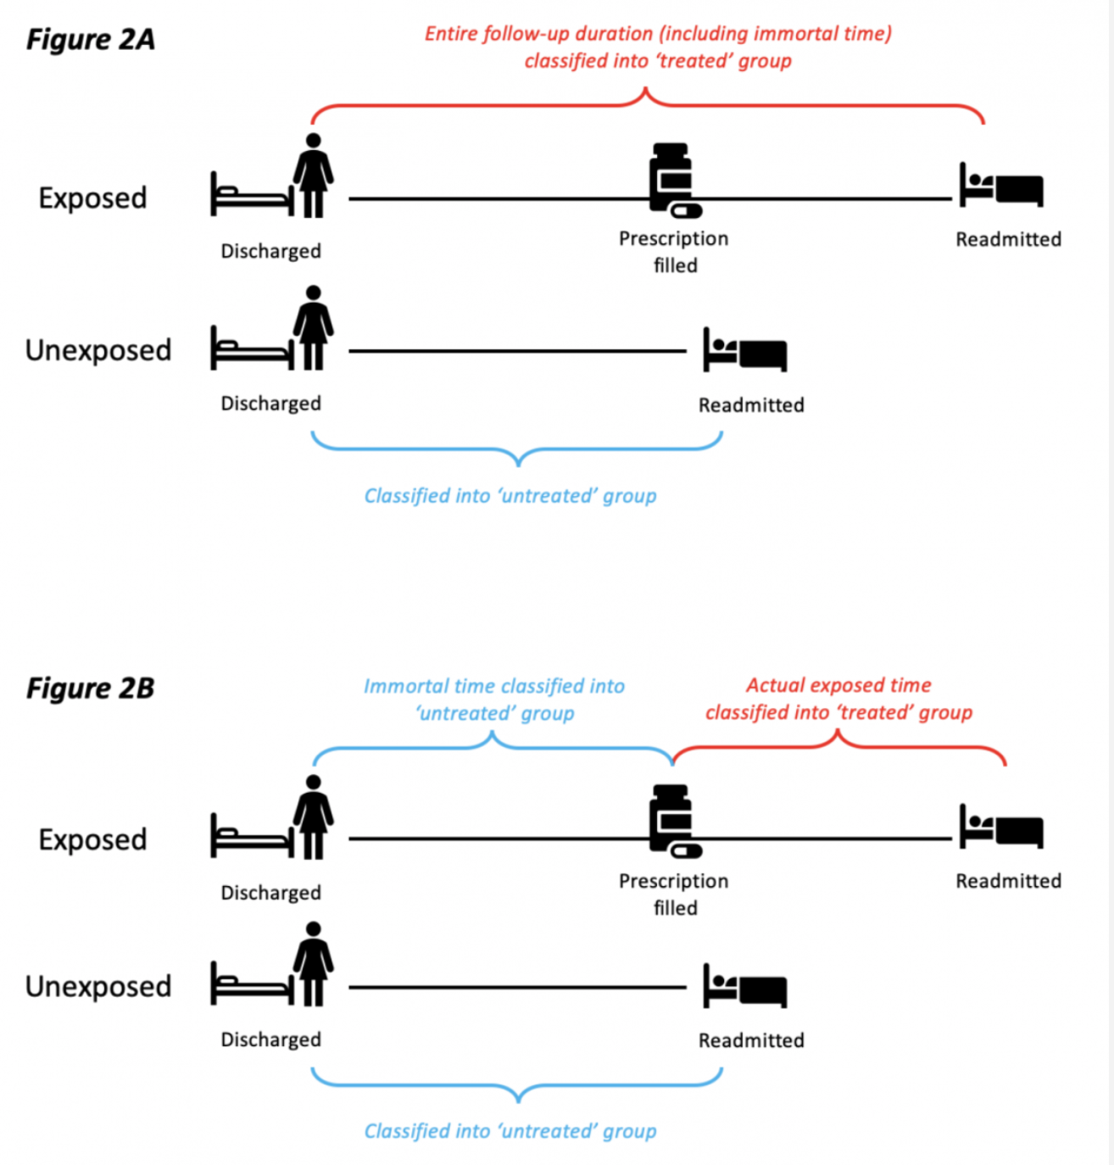
Immortal time bias
Can occur in observational studies that have periods of time in which exposed individuals cannot experience an outcome.
E.g. in a study of the effect of issuing a prescription vs not on readmission, by definition participants who receive a prescription cannot be readmitted before they receive their prescription.
Suissa, S. 2008. “Immortal Time Bias in Pharmacoepidemiology.” American Journal of Epidemiology 167 (4): 492–99.
Catalogue of Bias Collaboration. Lee H, Nunan D. Immortal time bias. In: Catalogue of Bias 2020. https://catalogofbias.org/biases/immortaltimebias/

Slide 23
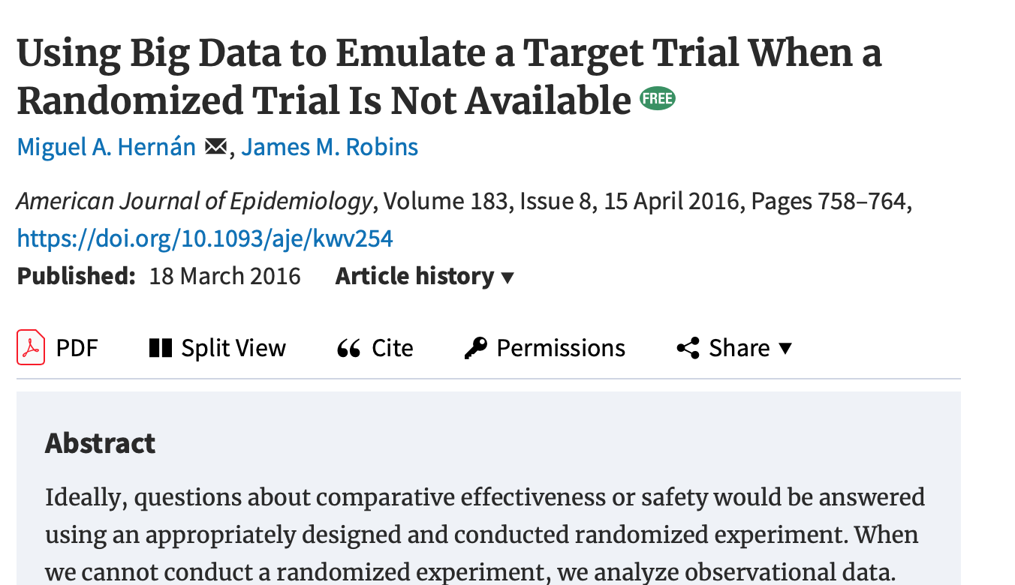
Target trial approach
Analyze observational data to emulate the desired trial as closely as possible.
Carefully define exposure, outcome and follow-up to match hypothetical RCT
Aims to recover causal estimates as comparable as possible with an RCT

Slide 24
Target trial approach
Suggested check list
Eligibility criteria
Treatment strategies
Assignment procedures
Follow-up period
Outcome
Causal contrasts of interest
Analysis plan

Slide 25
Target trial approach
Limitations
Many hypothesis are hard to fit within this framework
Gender
Ethnicity
Socioeconomic position
Relies on untestable assumptions of the estimation method (e.g. no unmeasured confounding or selection).

Slide 26
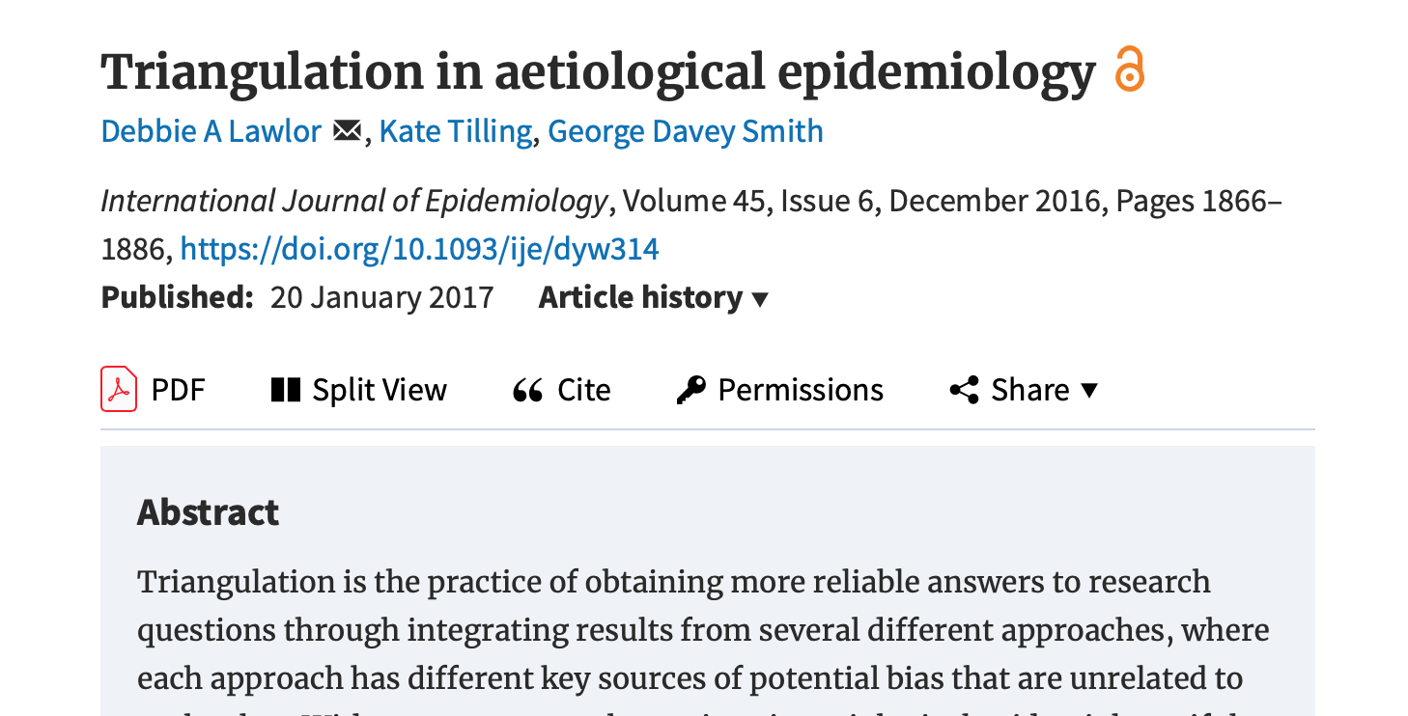
Triangulation

Slide 27
Causal inference methods
No unmeasured confounding of exposure-outcome relationship
Multivariable adjustment
Propensity scores
Inverse probability weighting
G-estimation
Other assumptions
Instrumental variable analysis
Regression discontinuity
Self controlled case series
Forms of natural experiments

Slide 28
How natural experiments can overcome confounding
Use Physician’s preference for ACE-I or other anti-hypertensive as an instrument.
The preference-COVID mortality association is a test of whether ACE-Is affect COVID mortality
This does not allow assumption free causal inference! The assumptions are just changed.
Age
Physician’s preference for ACE-I
Prescribed ACE-Inhibitor
COVID mortality

Slide 29
Sources of variation for natural experiments
Geographic
Variation in treatment rates
Density of physicians
Distance
Facility of physician treatment rates
Prescribing preference
Facility treatment rates
Interactions of distance and treatment rate
Age of physician
Nursing home preference
Date/time
Policy reforms Price
Patient morbidities
Wealth of spouse
Previous medical history
Number of injuries
Davies, Neil M, George Davey Smith, Frank Windmeijer, and Richard M Martin. 2013. “Issues in the Reporting and Conduct of Instrumental Variable Studies: A Systematic Review.” Epidemiology 24 (3): 363–69. https://doi.org/10.1097/EDE.0b013e31828abafb.

Slide 30
Sources of bias
Confounding
Confounding by indication/frailty
Selection/collider bias
Immortal time bias
Publication bias
Small study bias
Ascertainment bias
and many more – see https://catalogofbias.org/

Slide 31
Simulations
Simple simulations can be very informative
I have created two simulations on my GitHub here:
https://github.com/nmdavies/causal_inf_course/
reg_1_confounding.do – this simulates confounding and the important of measurement error
reg_2_selection_collider_bias.do – this simulates selection/collider bias

Slide 32
Summary
Large observational studies can provide unreliable evidence of causation
precisely wrong.
Methods for causal inference can help.
Weaker/more plausible assumptions
Often less precise – imprecisely right
Assumptions need to be spelt out
Often untestable
Possibly falsifiable

Slide 33
References
Rubin, Donald B. 1974. “Estimating Causal Effects of Treatments in Randomized and Nonrandomized Studies.” Journal of Educational Psychology 66 (5): 688–701. https://doi.org/10.1037/h0037350.
Lawlor, Debbie A., Kate Tilling, and George Davey Smith. 2016. “Triangulation in Aetiological Epidemiology.” International Journal of Epidemiology 45 (6): 1866–86. https://doi.org/10.1093/ije/dyw314.
Stampfer, M. J., C. H. Hennekens, J. E. Manson, G. A. Colditz, B. Rosner, and W. C. Willett. 1993. “Vitamin E Consumption and the Risk of Coronary Disease in Women.” The New England Journal of Medicine 328 (20): 1444–49. https://doi.org/10.1056/NEJM199305203282003.
Davey Smith, George, Michael V. Holmes, Neil M. Davies, and Shah Ebrahim. 2020. “Mendel’s Laws, Mendelian Randomization and Causal Inference in Observational Data: Substantive and Nomenclatural Issues.” European Journal of Epidemiology 35 (2): 99–111. https://doi.org/10.1007/s10654-020-00622-7.
Eidelman, Rachel S., Danielle Hollar, Patricia R. Hebert, Gervasio A. Lamas, and Charles H. Hennekens. 2004. “Randomized Trials of Vitamin E in the Treatment and Prevention of Cardiovascular Disease.” Archives of Internal Medicine 164 (14): 1552. https://doi.org/10.1001/archinte.164.14.1552.
Lawlor, Debbie A., Kate Tilling, and George Davey Smith. 2016. “Triangulation in Aetiological Epidemiology.” International Journal of Epidemiology 45 (6): 1866–86. https://doi.org/10.1093/ije/dyw314.
Davies, Neil M, George Davey Smith, Frank Windmeijer, and Richard M Martin. 2013. “Issues in the Reporting and Conduct of Instrumental Variable Studies: A Systematic Review.” Epidemiology 24 (3): 363–69. https://doi.org/10.1097/EDE.0b013e31828abafb.
Hernán, Miguel A., and James M. Robins. 2016. “Using Big Data to Emulate a Target Trial When a Randomized Trial Is Not Available: Table 1.” American Journal of Epidemiology 183 (8): 758–64. https://doi.org/10.1093/aje/kwv254.
Suissa, S. 2008. “Immortal Time Bias in Pharmacoepidemiology.” American Journal of Epidemiology 167 (4): 492–99.
Catalogue of Bias Collaboration. Lee H, Nunan D. Immortal time bias. In: Catalogue of Bias 2020. https://catalogofbias.org/biases/immortaltimebias/
Griffith, Gareth, Tim T Morris, Matt Tudball, Annie Herbert, Giulia Mancano, Lindsey Pike, Gemma C Sharp, et al. 2020. “Collider Bias Undermines Our Understanding of COVID-19 Disease Risk and Severity.” Preprint. Epidemiology. https://doi.org/10.1101/2020.05.04.20090506.
Hernán, MA, and JM Robins. 2020. Causal Inference. Boca Raton: Chapman & Hall/CRC, forthcoming.
Imbens, Guido, and Donald B. Rubin. 2015. Causal Inference for Statistics, Social, and Biomedical Sciences: An Introduction. New York: Cambridge University Press.
Pearl, Judea. 2000. Causality: Models, Reasoning, and Inference. Cambridge, U.K. ; New York: Cambridge University Press.

